Slide 1
Farm Fresh
Grocery Ordering System
Presented By:
Team Quadro
Team Members:
Sanya Tandon (RA1711020010082)
Sweta Sarat (RA1711020010104)
Damman Bhatia (RA1711020010081)
Somesh Dave (RA1711020010087)

Slide 2
The Problem :-
The influx of centralized grocery and vegetable delivery systems has made a rapid decline in the market share of local vendors and grocery stores.
The business has become over dominated by the big players leaving nothing for the small operators.
The same product is being sold for a higher price in the name of quality assurance.
The basic needs of the customers are being exploited as a part of money making business strategy.

Slide 3
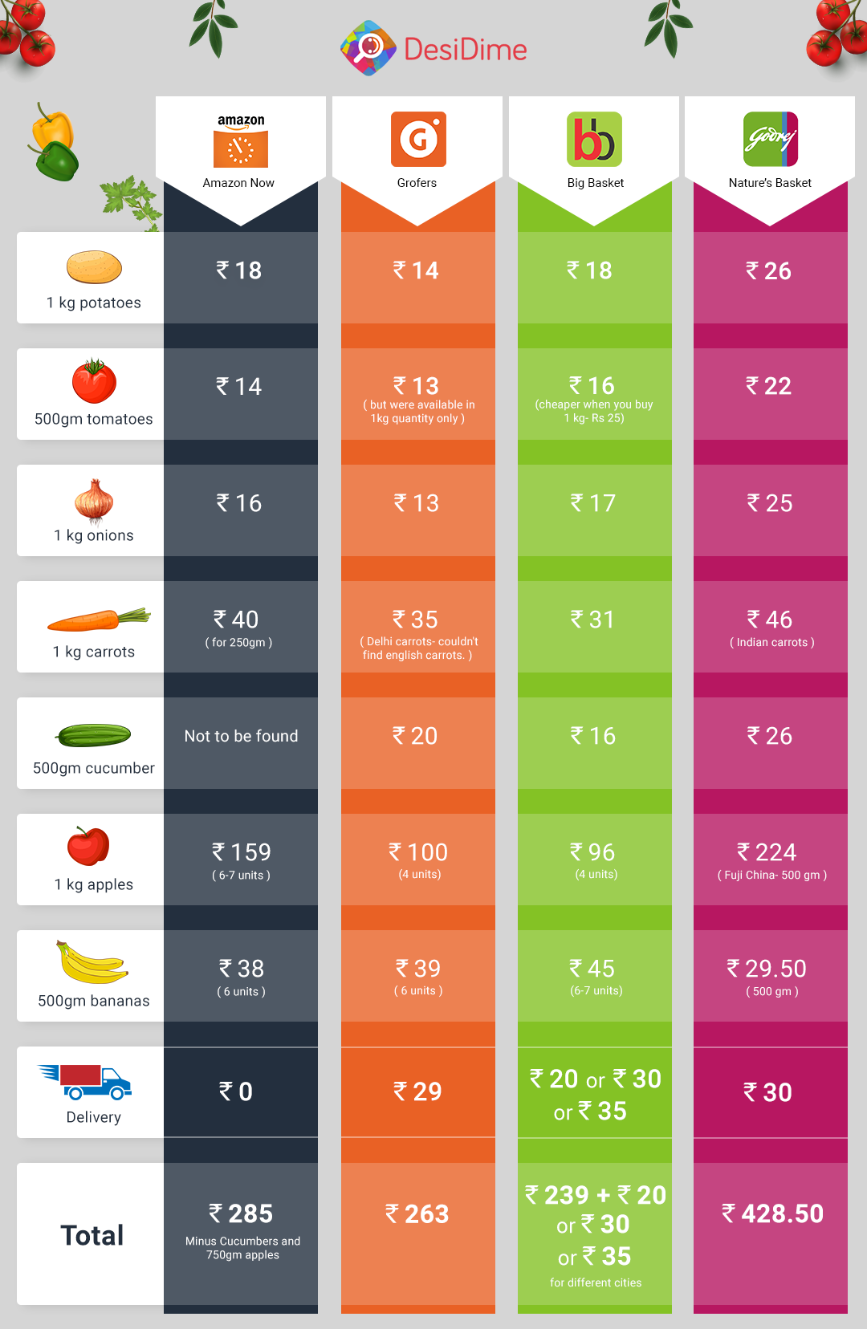
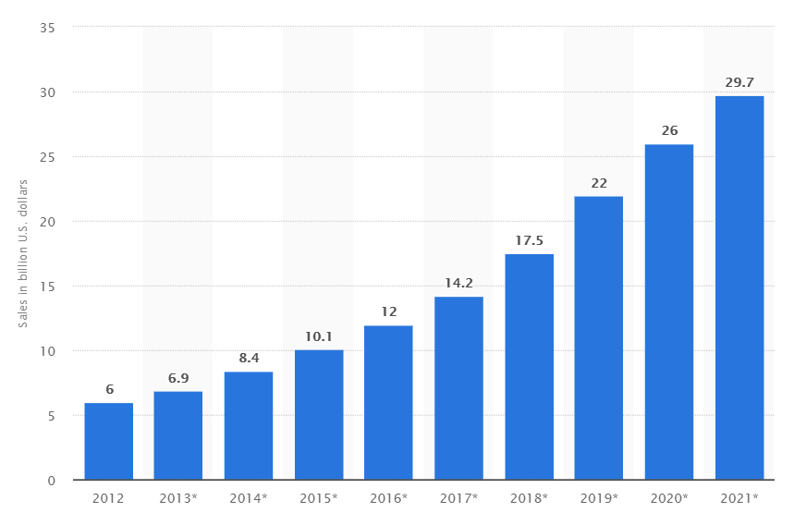
The Statistics :-
As stated previously the items are overpriced on an average by 5-10 Rupees per kg with different enterprises targetting different products.
A steady growth is expected for these enterprises due to various reasons such as the busy lifestyle of this generation and others.
The end result being non-wholistic growth of the economy.

Slide 4
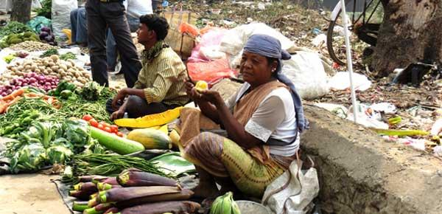
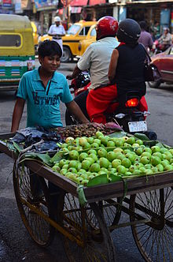
The Motivation:-
To see such situations existing in a modern society calls for someone to take an initiative and do something about it.
As future engineers this would be one of the ways we could help the society.

Slide 5
Proposed Solution:-
Farm Fresh aims to decentralize the market once again in order to include all those small fragments that have been excluded by the big players.
Eventually all these fragments would continue to operate independently but by being registered under Farm Fresh would gain access to their lost market by getting the ease of access element from us.
This would thus make the monopolising of the business to cease to exist .
The customers would get access to an even diverse market having more choices to select from.
Farm Fresh would safeguard the customers from being exploited by over paying for the same product.

Slide 6
How are we better:-
No storage requirements as we are just connecting the already existing markets back to its customers.
Lower delivery charges as we don't mass deliver using heavy duty vehicles but would instead create 5km zones and would utilize bicycles customized for the purpose thus cutting down on the costs and also being enviroment friendly at the same time, thus the name “Farm Fresh”.
Cutting down on middle-men eventually making customer and seller interact directly allowing benefits to both.
Initiative to integrate Government Help and Funding into the project thus allowing it to sustain without overcharging the already poor local vendors as this would be a not for profit project which could sustain itself.
Give insights to the local vendors on how to expand and diversify their business.

Slide 7
Challenges:-
Ensuring quality of the products as the system is so diversified.
Convincing the local vendors to change their business strategy.
Connecting the uneducated vendors to smartphone technology and internet.
Setting up of hotspots for delivery personnel.
Get the initial push to come in direct contest with the big players.

Slide 8
Current Approach:-
Buyers and Sellers register themselves into our system using our application.
Seller gets the option to edit his items for sale on an everyday basis. The same is then displayed on the app through our database.
Customer can search for the items he wants to purchase.
Customer then selects the seller.
Customer checks out using any of the payment methods.
Seller receives the order and at the same time a delivery personell is assigned to handle the current order.
The order is prepared and delivered to the customer's registered address.

Slide 9

Time For A Deeper Look At Our System

Slide 10
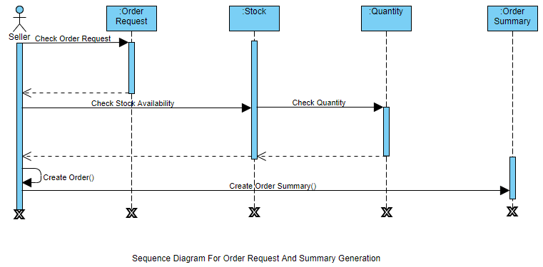
Sequence Diagram:-
Order Request and Summary Generation

Slide 11
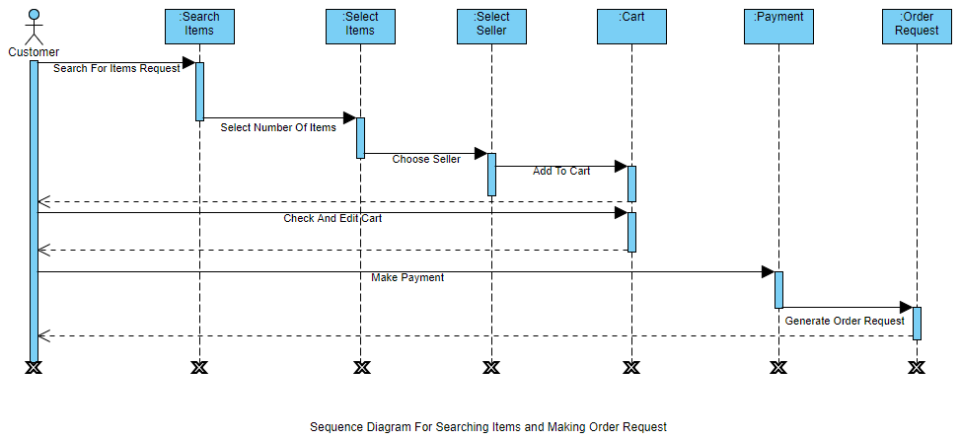
Sequence Diagram:-
Searching Items and Making Order Request

Slide 12
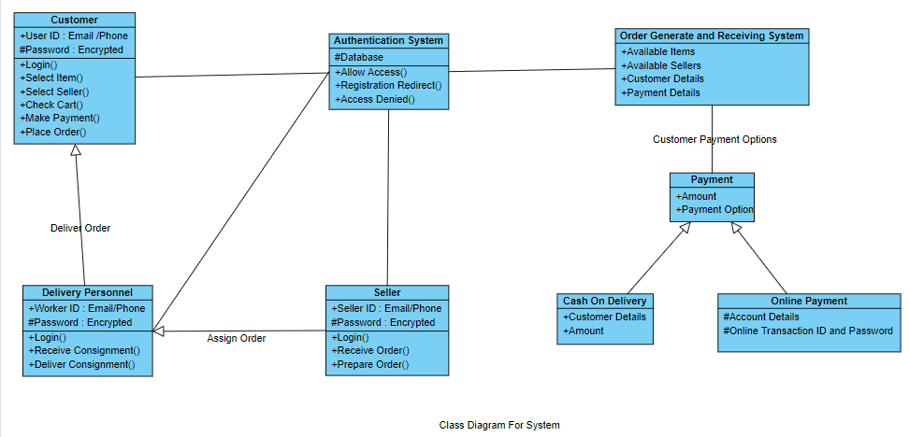
Class Diagram:-
Class Diagram For Farm Fresh

Slide 13
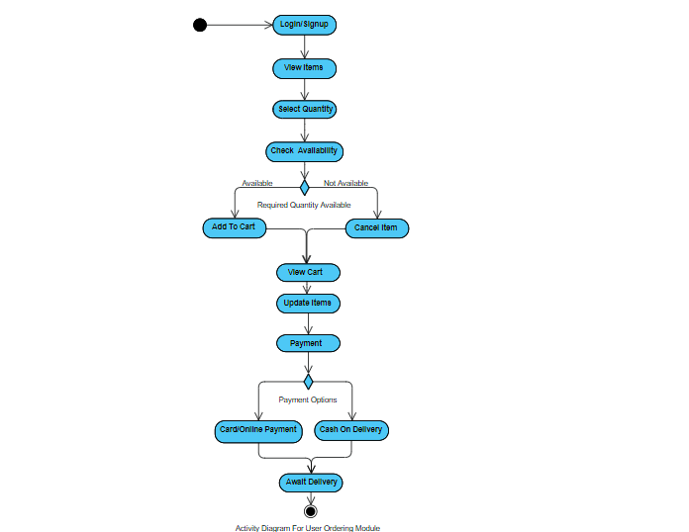
Activity Diagram:-

Slide 14
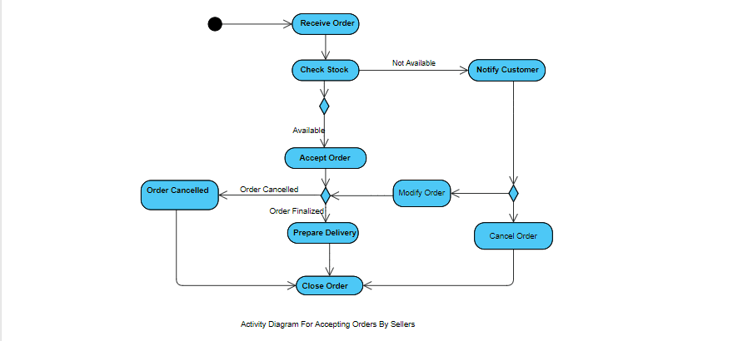
Activity Diagram:-

Slide 15
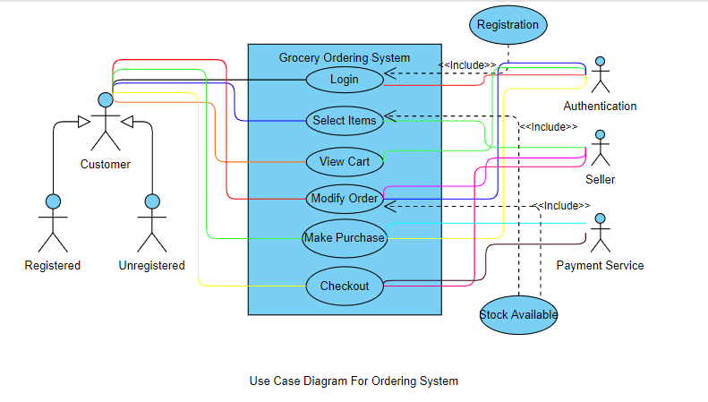
Use Case Diagram:-

Slide 16
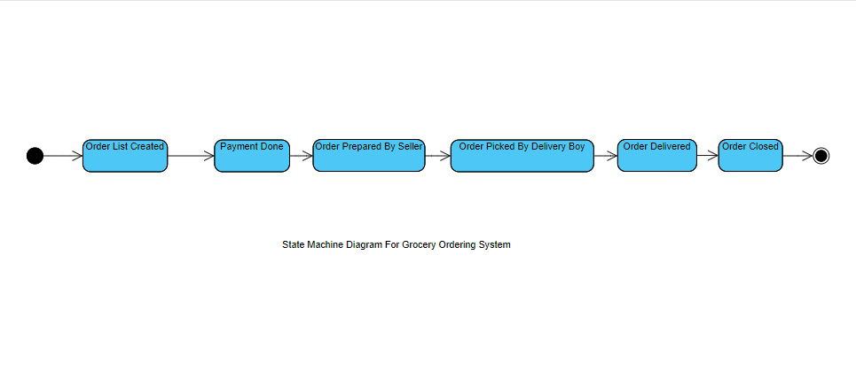
State Machine Diagram:-

Slide 17
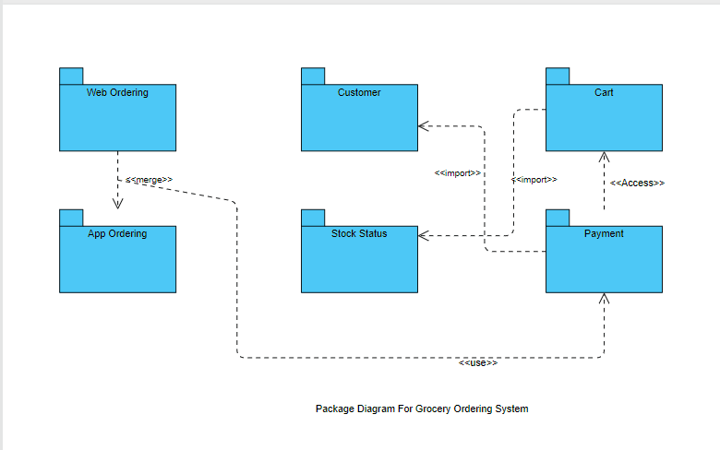
Package Diagram:-

Slide 18
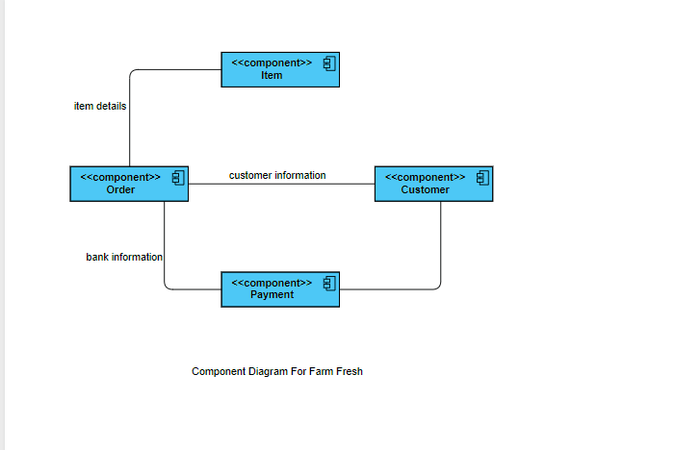
Component Diagram:-

Slide 19
In the end :-
Customer
Market
We hope we can put the pieces together and make successful efforts for a better tomorrow.
Delivery
Growth

Slide 20
T
H
A
N
K
S

